Slide 1
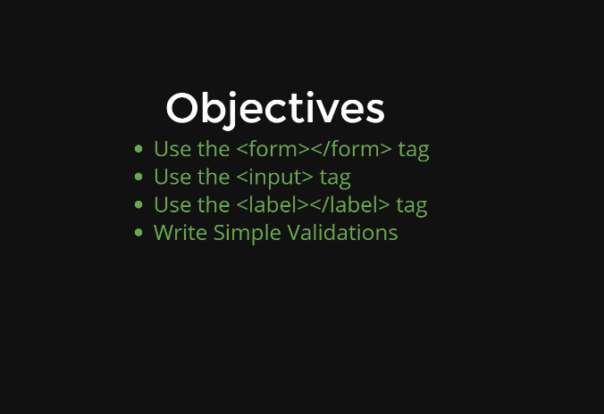

Slide 2
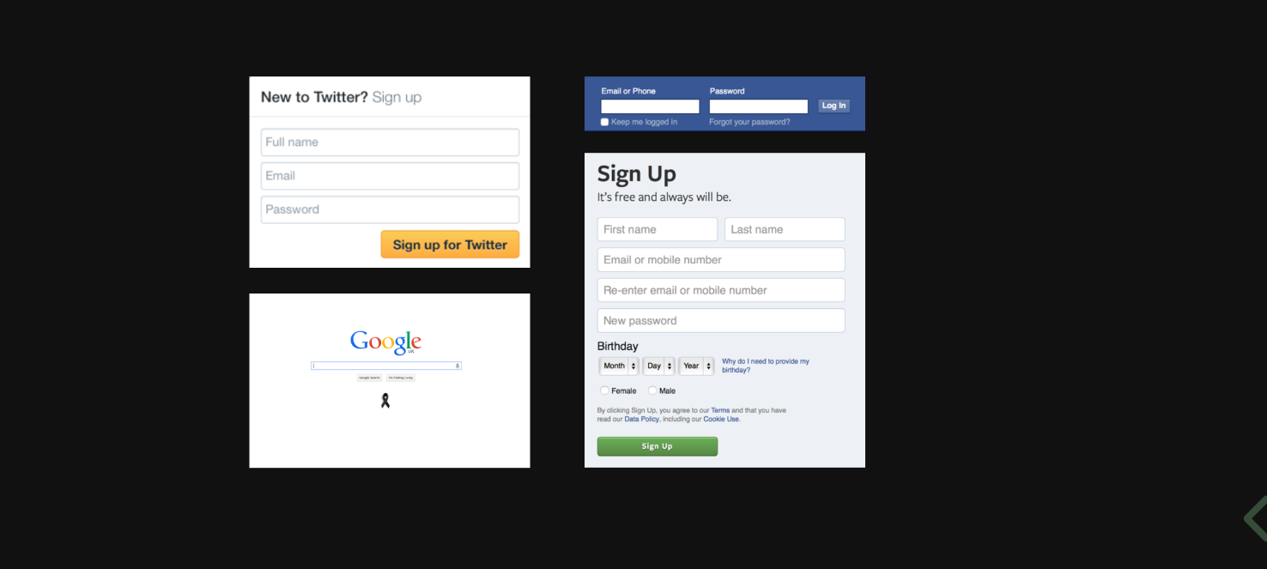

Slide 3
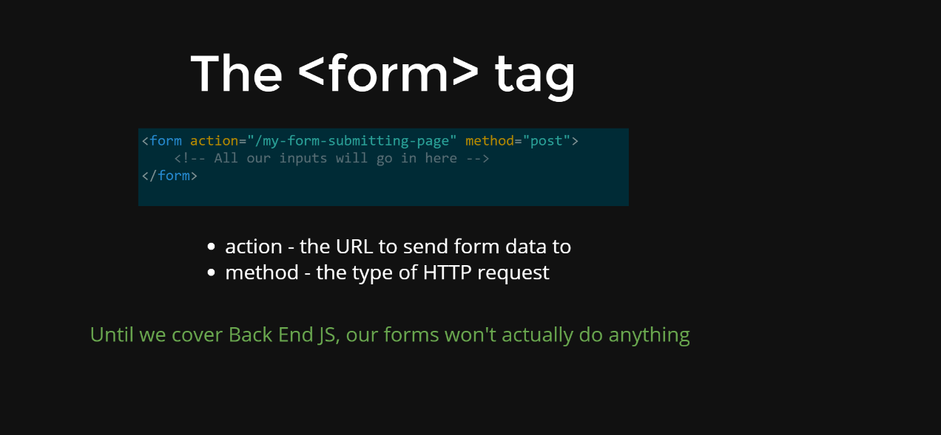

Slide 4
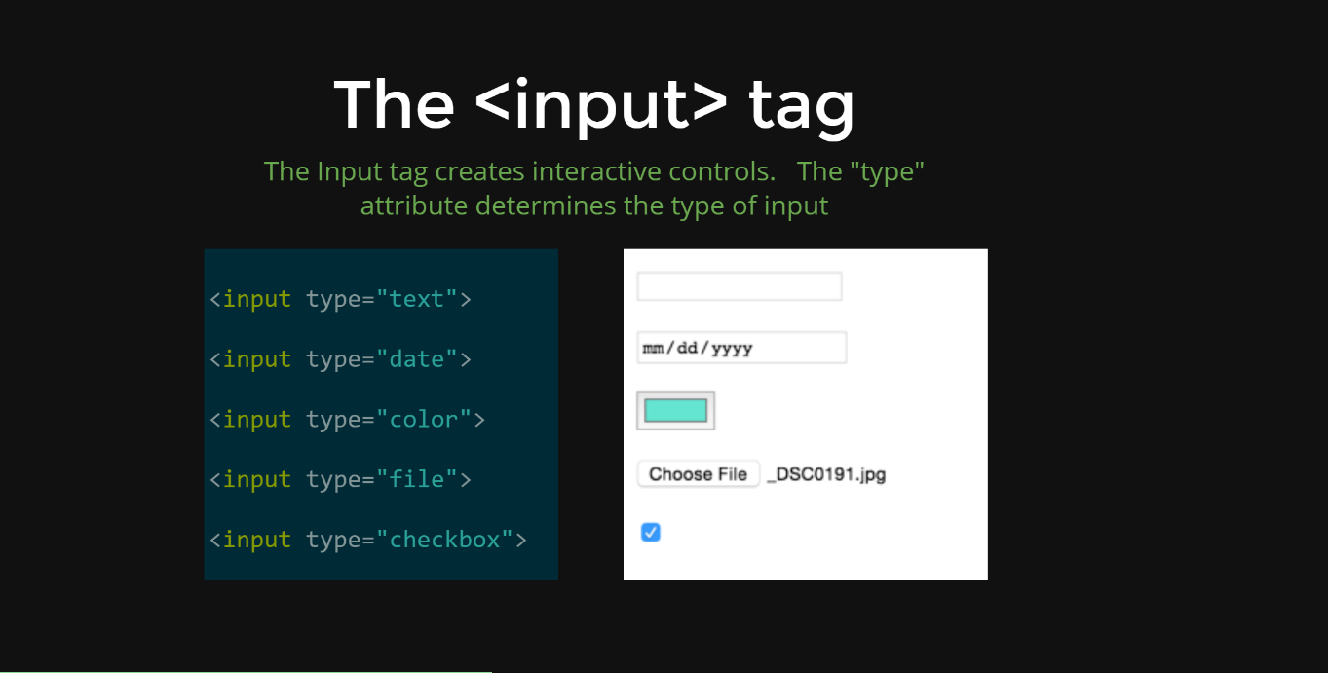

Slide 5
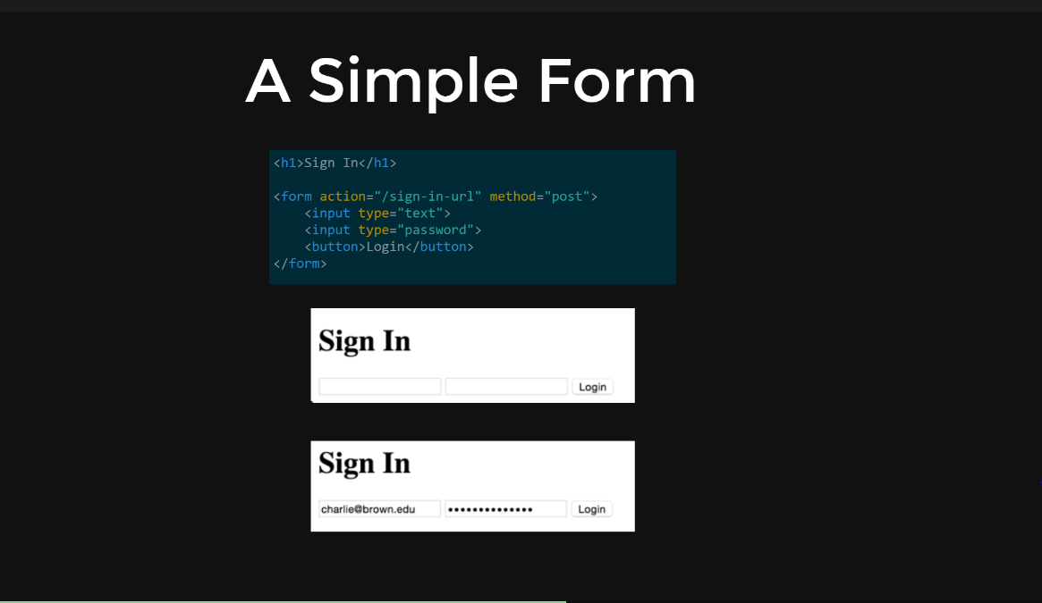

Slide 6
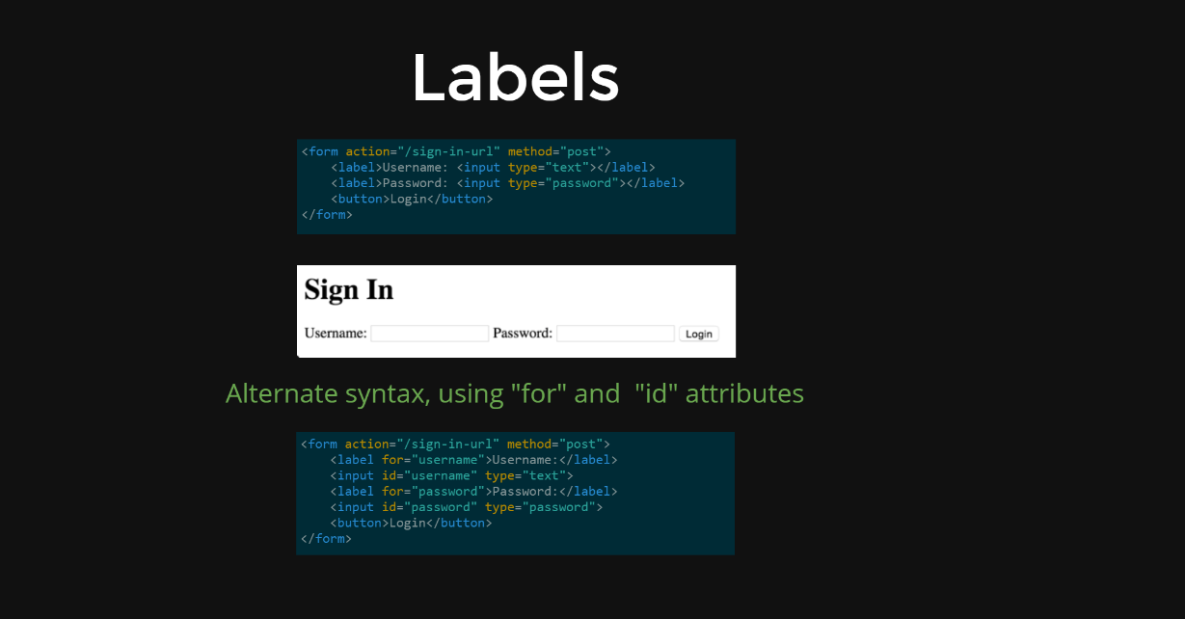

Slide 7
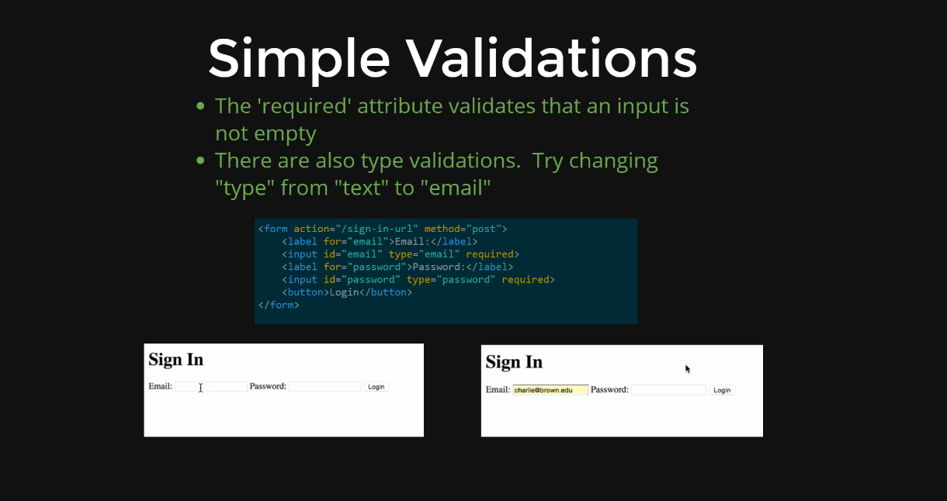

Slide 8
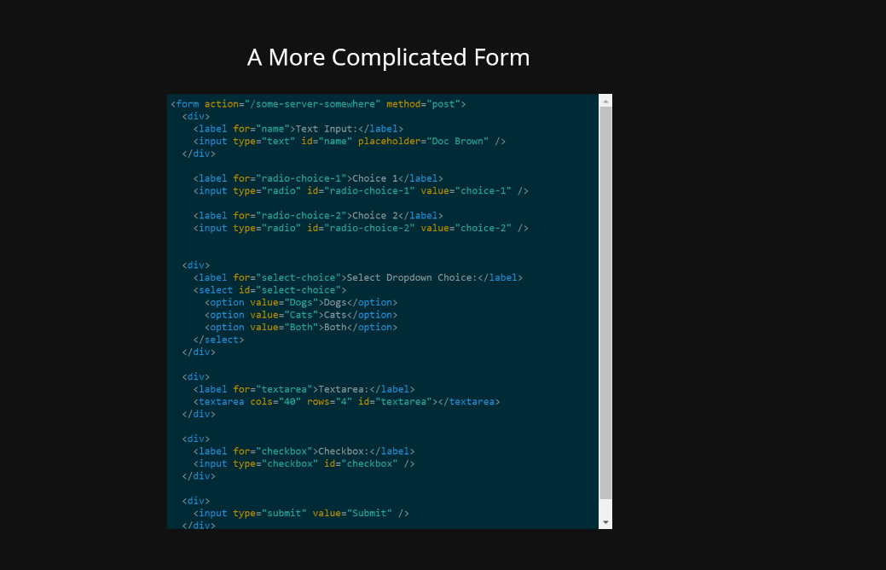

Slide 9
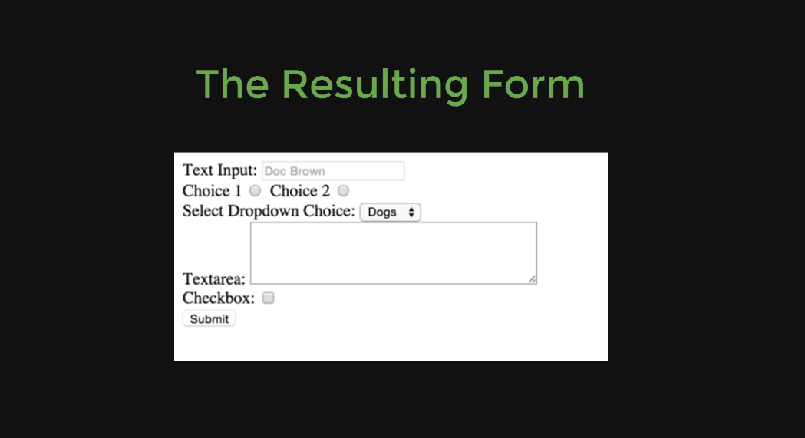

Slide 10
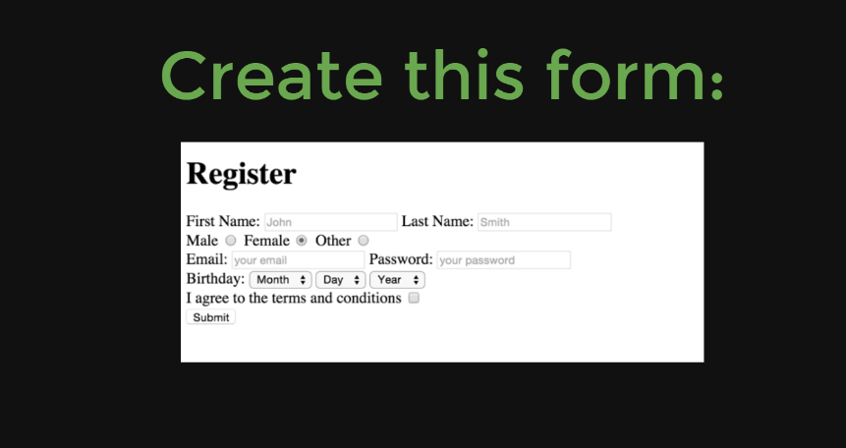

Slide 11
You’ll need to use:
Text input
Password Input
Email Input
Radio Buttons
Select Tag
Checkbox Input
Validations:
First Name, Last Name, and Email are required
Email must be a valid email address
Password must be btw 5-10 characters
Birthday 3 drop down menus for month day year

